Slide 1
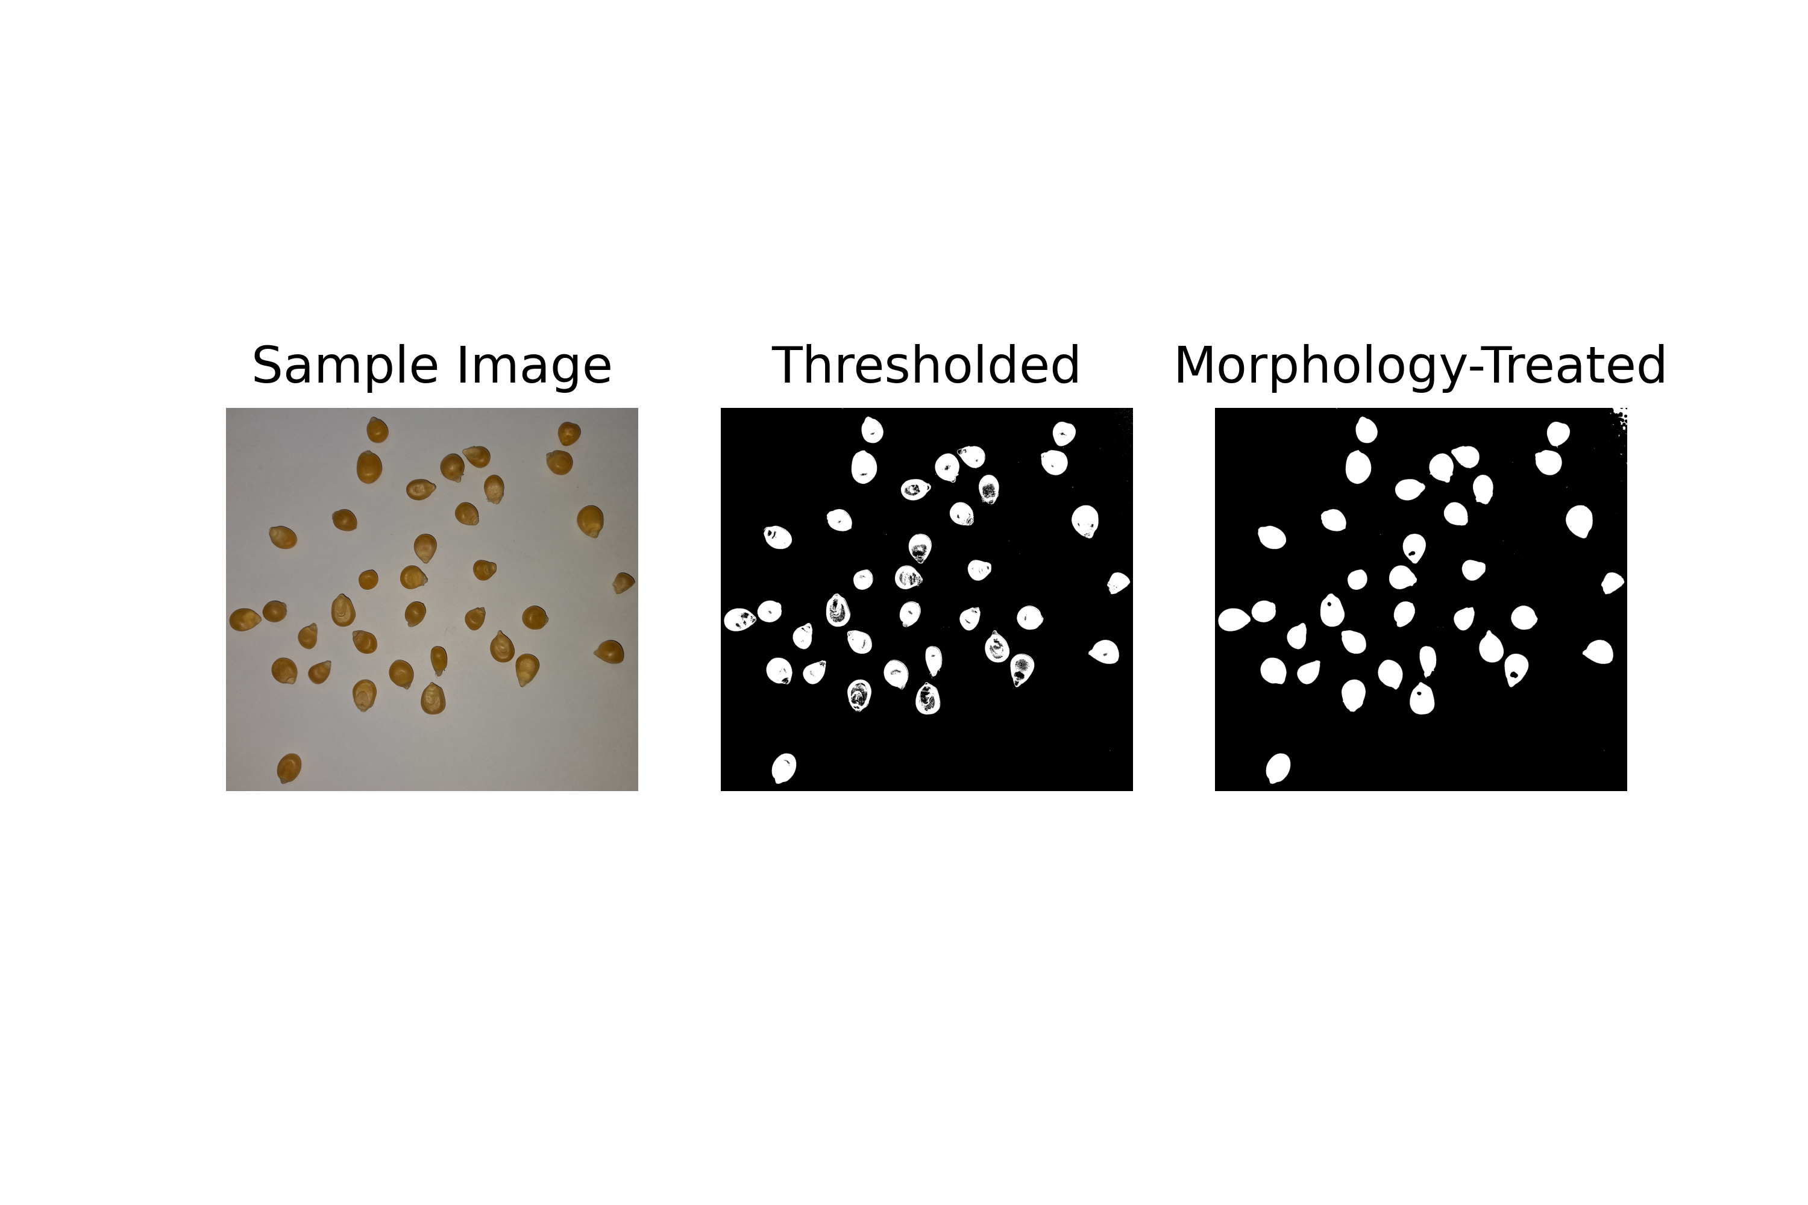
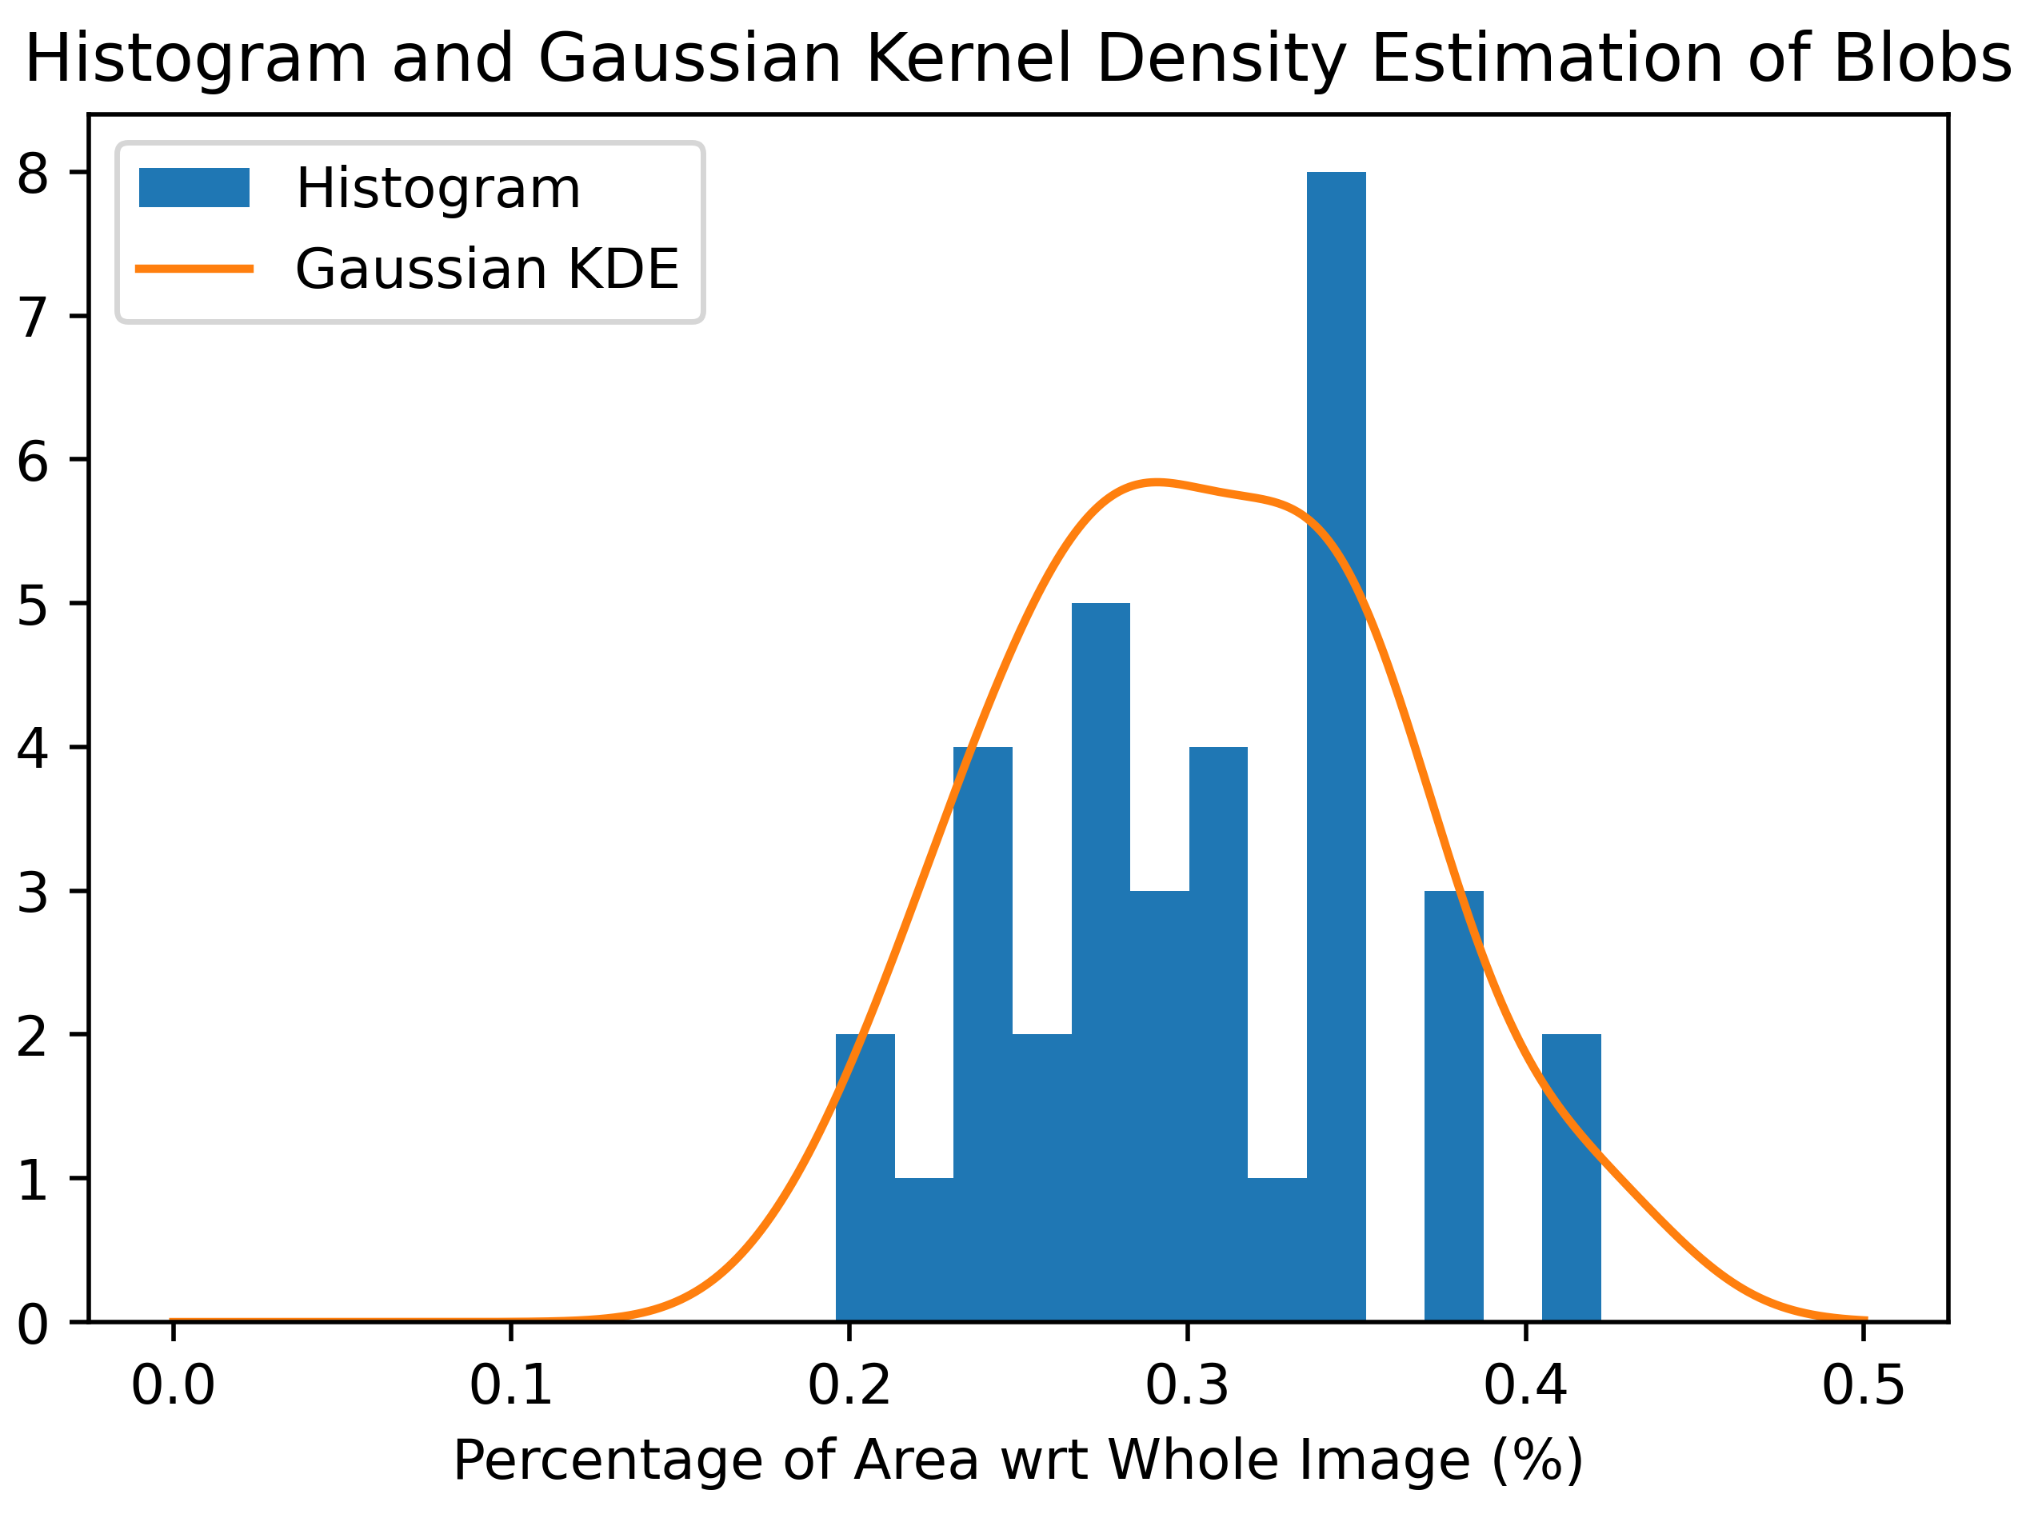
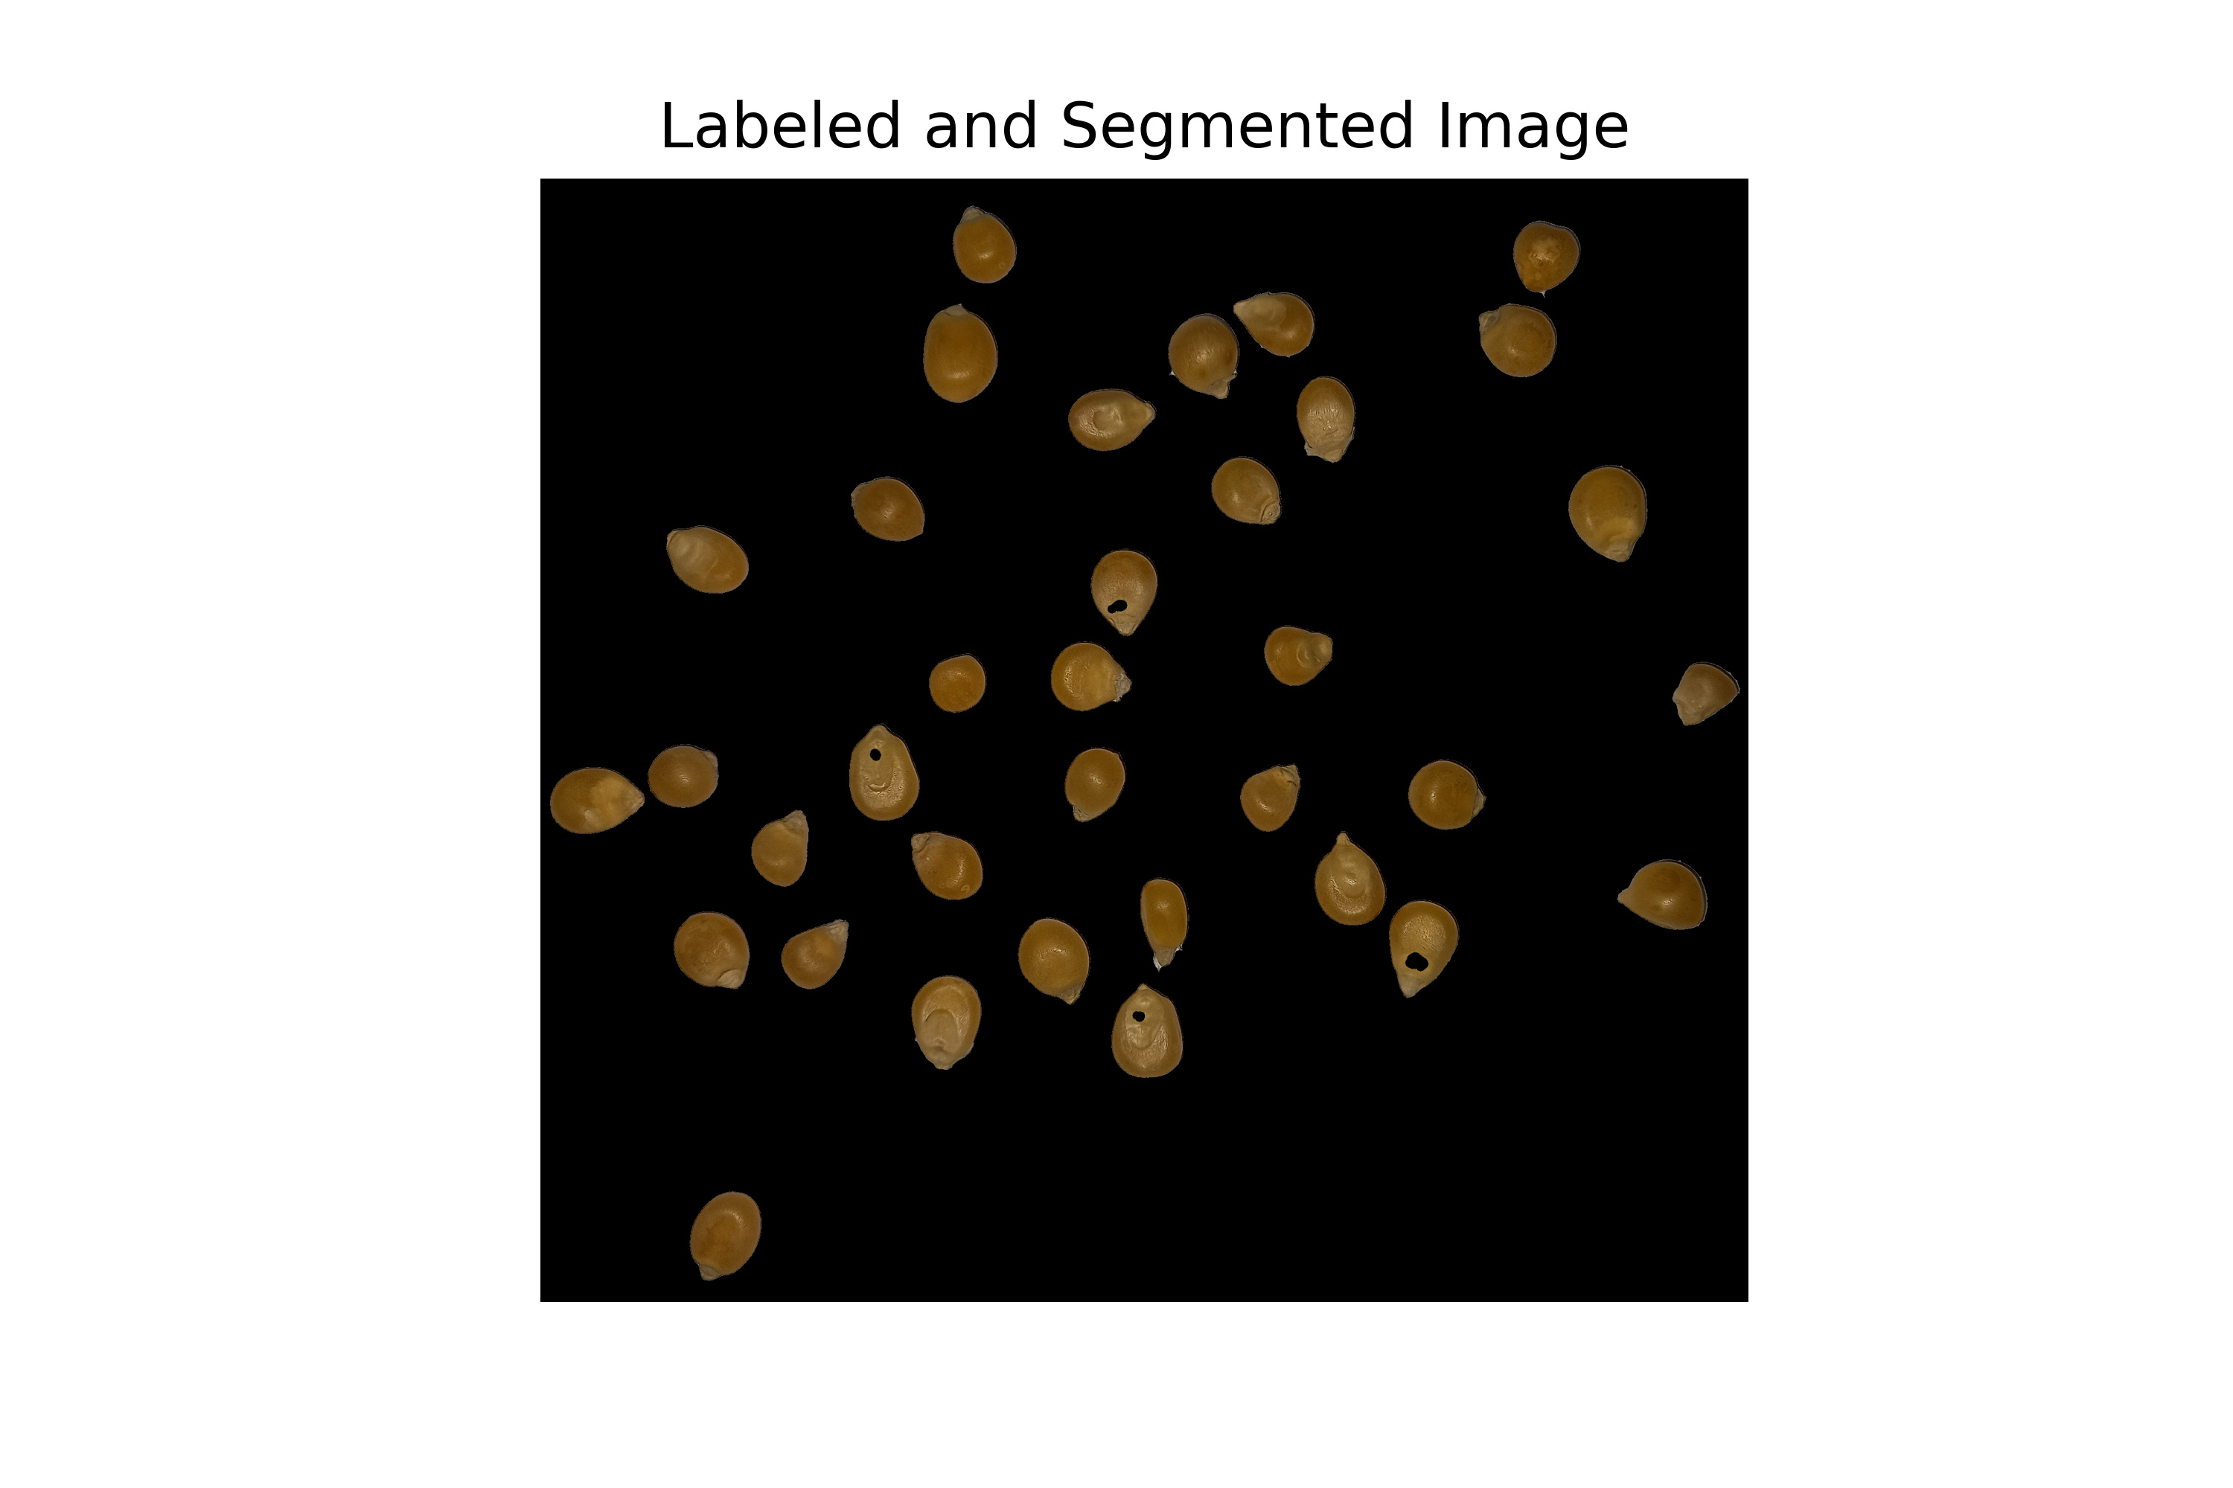
Feature Extraction from Labeled Blobs
App Physics 157 FX-1 1 of 6
Presented by Soriano, Edneil E. Jr.
S.N. 202002420

Slide 2
Objectives
App Physics 157 FX-1 2 of 6
To apply image segmentation techniques and morphological operations in isolating desired objects from an image.
To label and measure various properties for all objects of interest

Slide 3
App Physics 157 FX-1 3 of 6
Image Segmentation and Morphological Treatment
In this exercise, we analyze tamarind candies taken in random and spread out as shown in Fig 1 (left).
Notice that the binarization is not perfect – there are holes present inside the blobs and noise present in the background. In order to clean up this image, we apply image morphology. In particular, we apply the closing operator to our binarized image, the result of which is shown in Fig 1 (right).
The result is much cleaner, but it still isn’t perfect. For our current application this will get the job done. However, if we want a better binarization we can do the following:
Apply the closing operator multiple times, but this will reduce the size of each blob
Use skimage’s area_closing method to close holes
Apply the opening operator an equal number of time to recover the edges of blobs
However for our current purposes, however this isn’t necessary as the image is clean enough for the next algorithm.
Fig 1. RGB image used (left), segmented by thresholding (middle), and treated with the closing operator (right).
Now in order to label and extract properties from each candy, we need to segment the image first. In this case since the objects contrast the background in grayscale, we use simple thresholding to binarize the image. The resultant binarized image is shown in Fig 1 (middle). In this case, the threshold value used was 110 and the image shown in the figure is actually and inverted array of the threshold-treated image (which is needed).

Slide 4
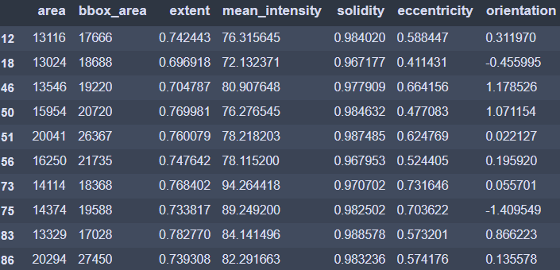
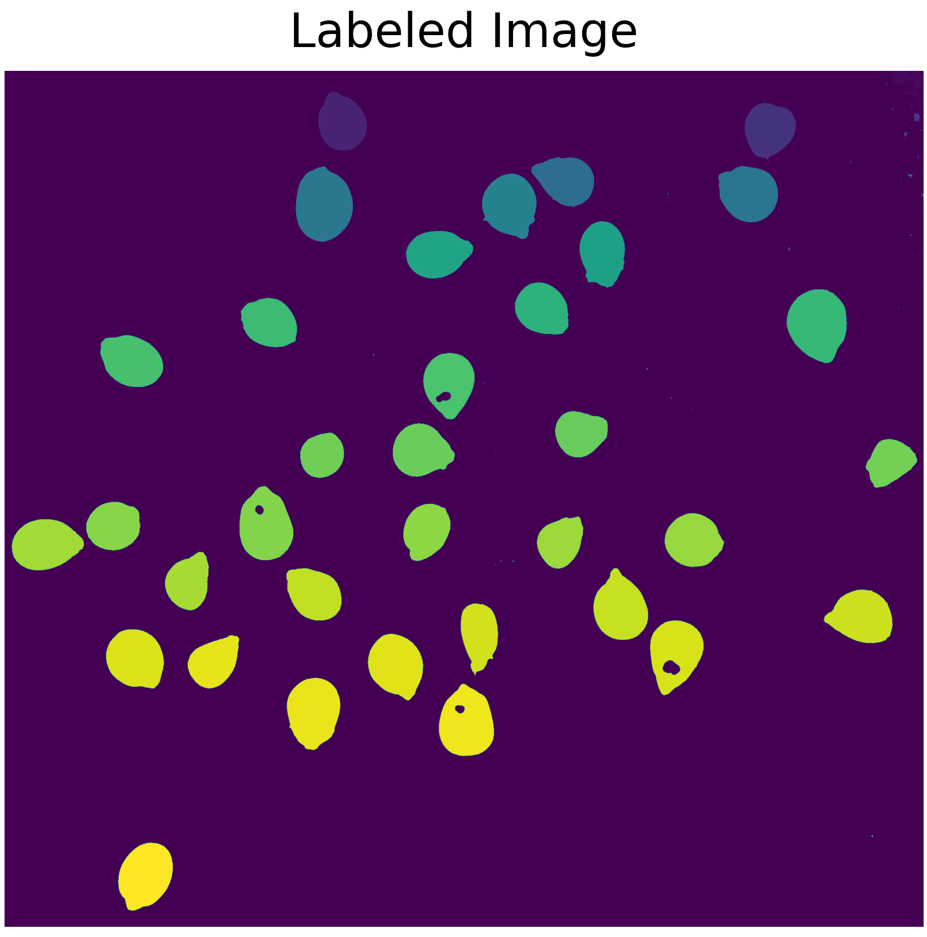
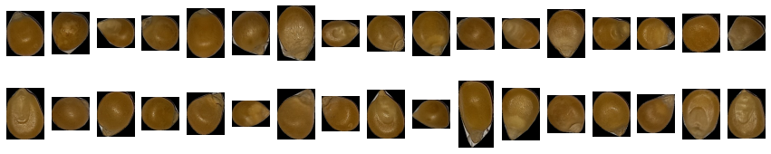
App Physics 157 FX-1 4 of 6
Labeling and Feature Extraction
Table 1. Properties of accepted regions based on area thresholding
Now we are ready to analyze our blobs – the step of which is to label our regions into separate entities. We do this by calling skimage.measure.label. The resulting labeled is shown in Fig 2.
We end up with 35 blobs (just as we expect), and 34 (for symmetry of the plot) of them are shown below in Fig 3.
Fig 2. Labeled image where the gradient reflects indexing. We can see that the method starts goes from top to bottom, and left to right.
Now we are ready to get the properties of each blob. We do this with the skimage.measure.regionprops_table. However, we filter out entries with areas below a threshold to filter out noise. Some of the accepted regions are shown in Table 1.
Fig 3. Accepted blobs from the image using an area threshold

Slide 5
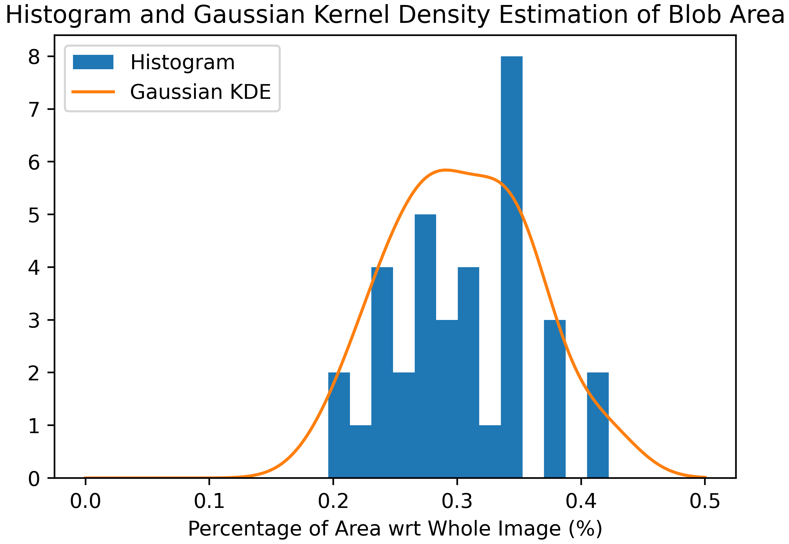
App Physics 157 FX-1 5 of 6
Labeling and Feature Extraction
Now that we have the properties of all the blobs in our image, what do we do with it? In this example, I have chosen to determine the distribution of areas for randomly distributed candies. In theory, this will follow a pseudo-normal distribution. I generate a histogram then employ a Gaussian kernel density estimation to generate a probability density function for candy area. The results are shown below:
For us to appreciate this process more, I overlay the selected blobs to the original image to show a rudimentary form of machine vision.
Fig 4. Image segmentation and labelling without machine learning.
We can see that there are errors in the form of small holes in our objects. These contribute to errors in the measured properties, but I think these errors are negligible in the statistical analysis we will do later. The image above is labeled and segmented, we can use this information later on for simple machine learning algorithms like k-nearest neighbor!
We can see that the areas follow the shape of a single Gaussian. With this result, we now have a function to predict the areas for any future tamarind candies that we may want to make. This has direct application in product packaging! We can do all sorts of analyses with the properties we extracted from the blobs.

Slide 6
Key Takeaways
App Physics 157 FX-1 6 of 6
In order to conduct blob analysis, one needs competencies in image segmentation and morphological operations
The labeling and extraction of blob features can be done in Python with the skimage module.
Reflection
As I see it, this module presents us with the methods to prepare data sets in order to train basic machine learning models – especially classifiers. The ability to segment and label objects in an image along with measuring their properties with an automated script is a very useful tool when dealing with hundreds of images. I was also able to apply concepts I learned in Physics 191 (Experimental Physics 1) given the data extracted from the blobs. This activity has very wide applications, and so I was quite interested while doing it.
I did all necessary tasks and did more by more than what was stated in the module. I also had to learn how to implement masks and how they interact with dataframes, which took quite a bit of time. Hence, I think I deserve a 100/100 and any bonus points the instructor deems necessary!
References
[1] Soriano, M. (2023). Feature Extraction from Labeled Blobs. App Physics 157. National Institute of Physics, UP- Diliman.
[2] Scikit-Image documentation: https://scikit-image.org/docs/stable/api/skimage.measure.html
[3] Manansala J. (2021). Image Processing with Python: Connected Components and Region Labeling. https://medium.com/swlh/image-processing-with-python-connected-components-and-region-labeling-3eef1864b951

